Slide 1
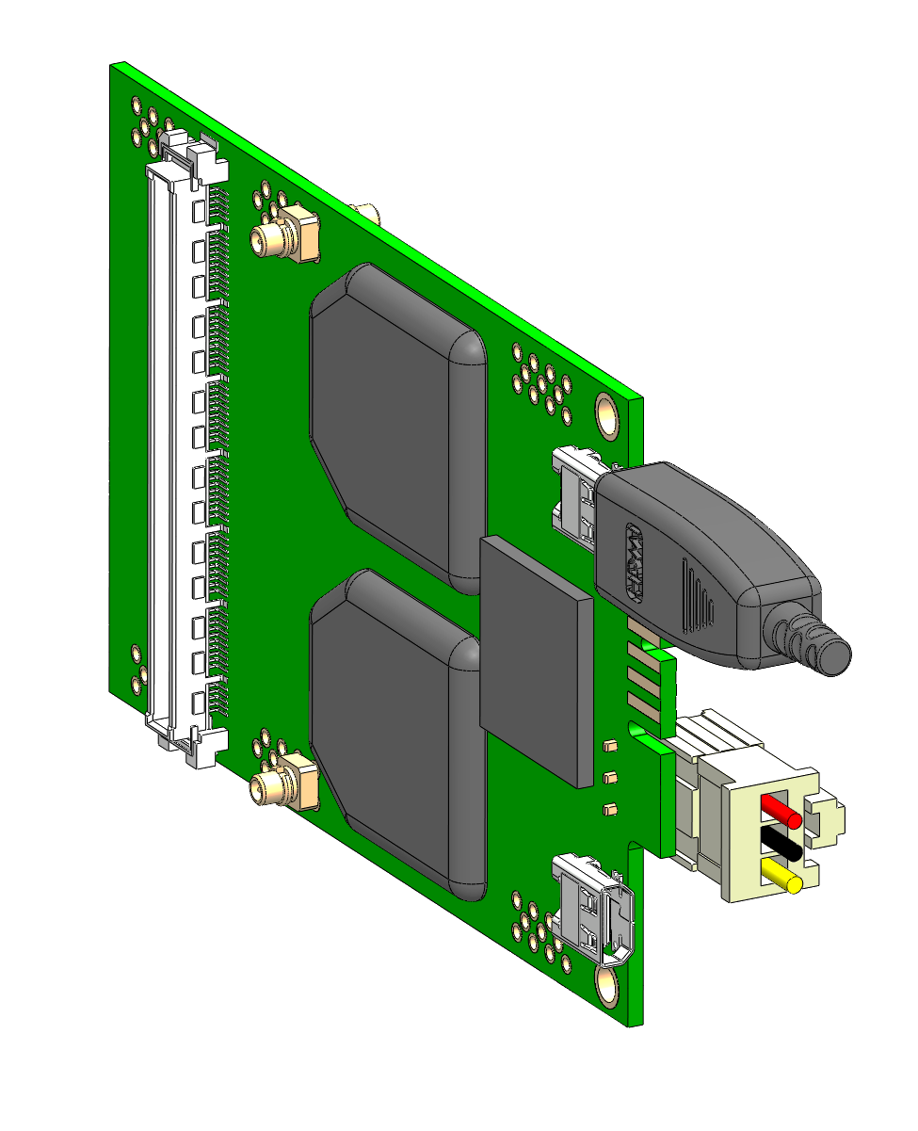
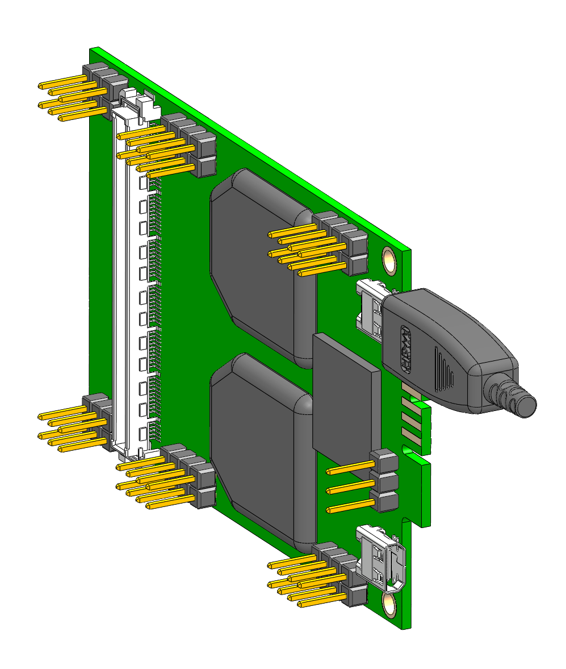
Add PinHeader 2.54 pitch
Remove Power and Heatsink connectors

Slide 2
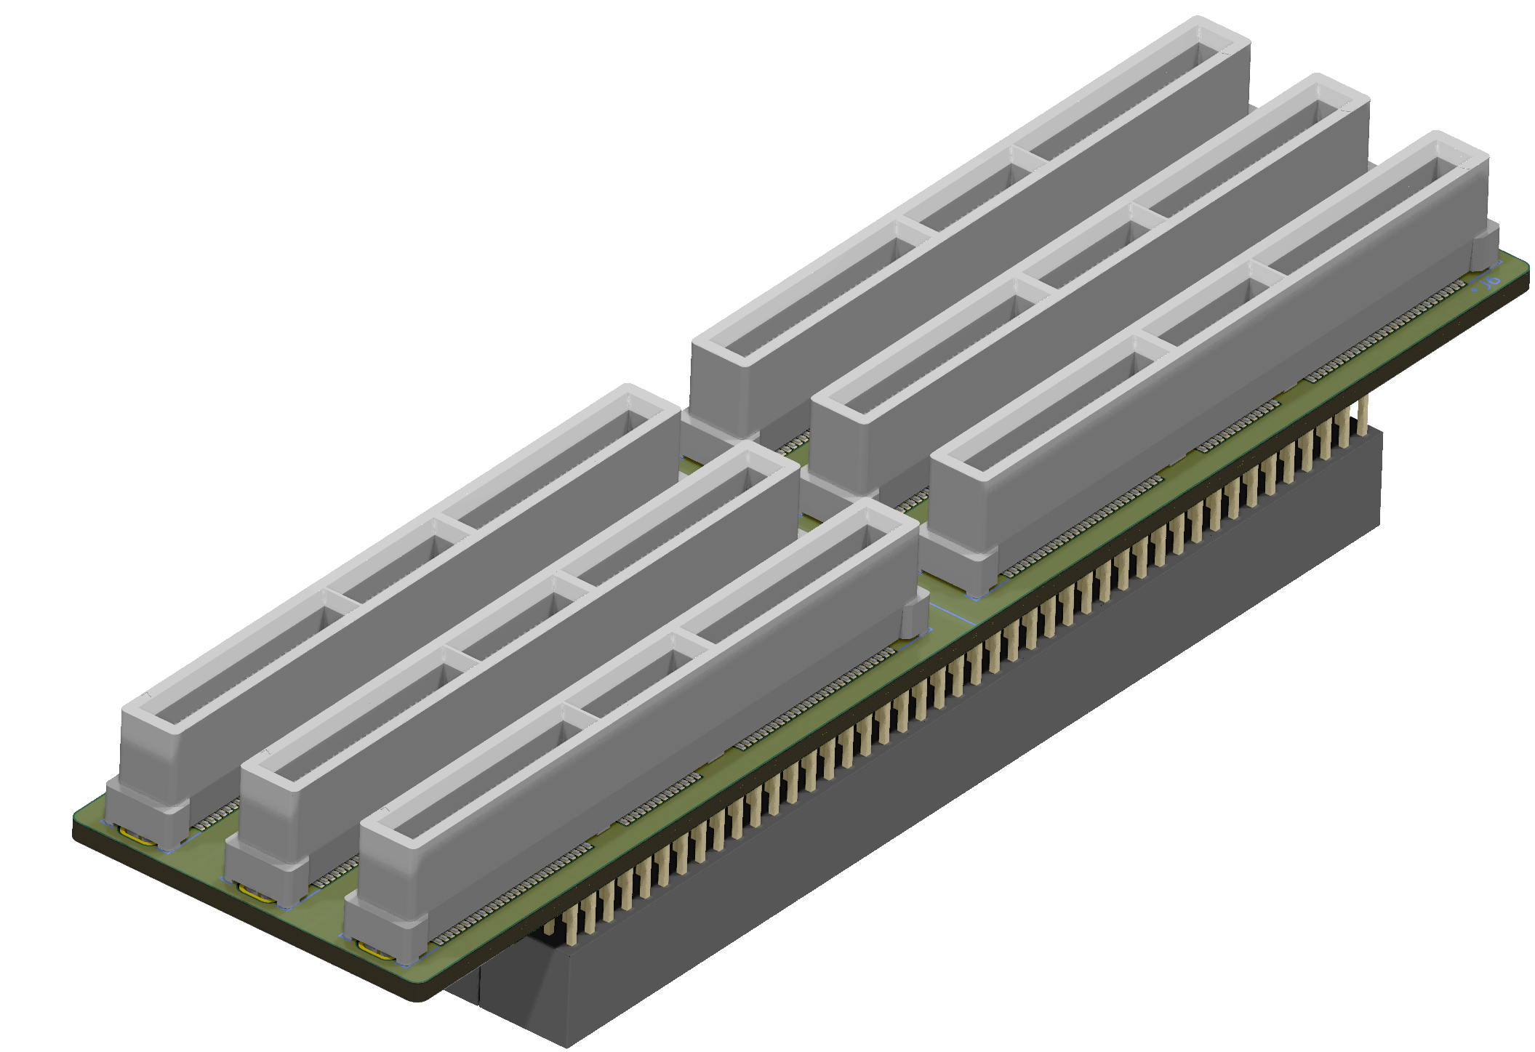
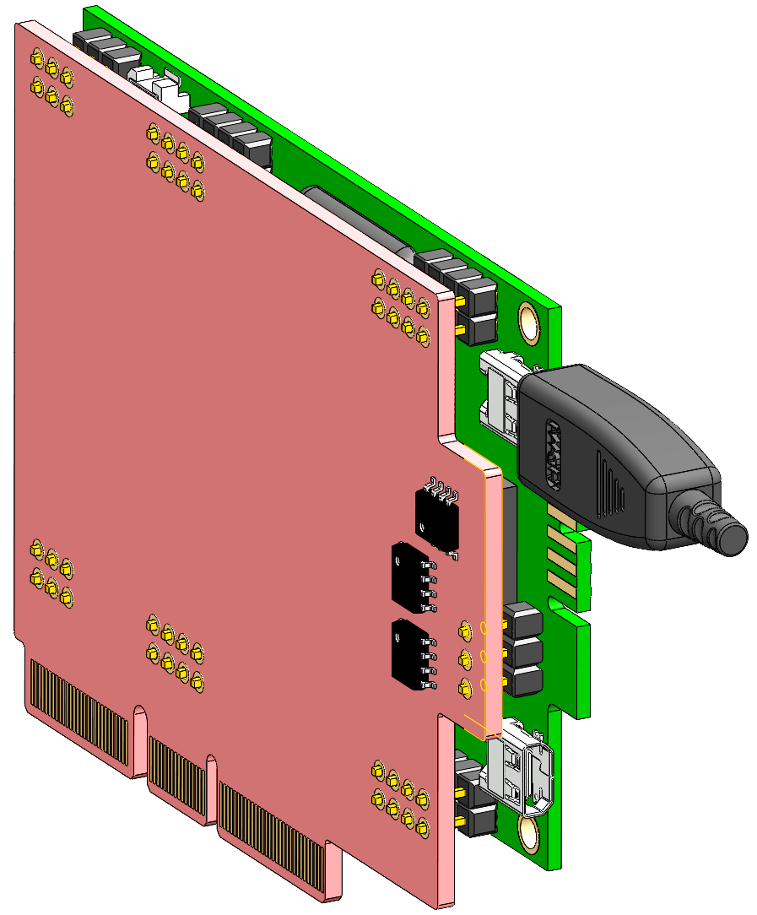
10.6 mm
Voltage regulators for P1&P2 phases of 3.3V/0.2A and 1.8V/1.7A
VMM3 Hybrid soldered on our card adapter
- all pin headers are cut at the appropriate length
- power is delivered through the card via 28 pins

Slide 3
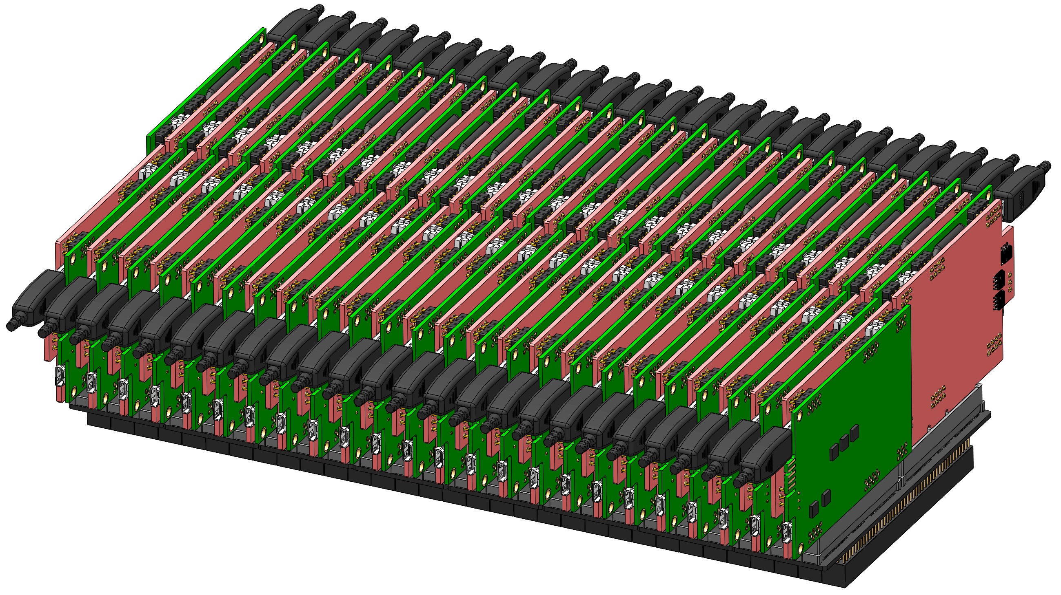
- All cards required for the readout of the entire TPC
- The distance between two cards is 10.66 mm

Slide 4
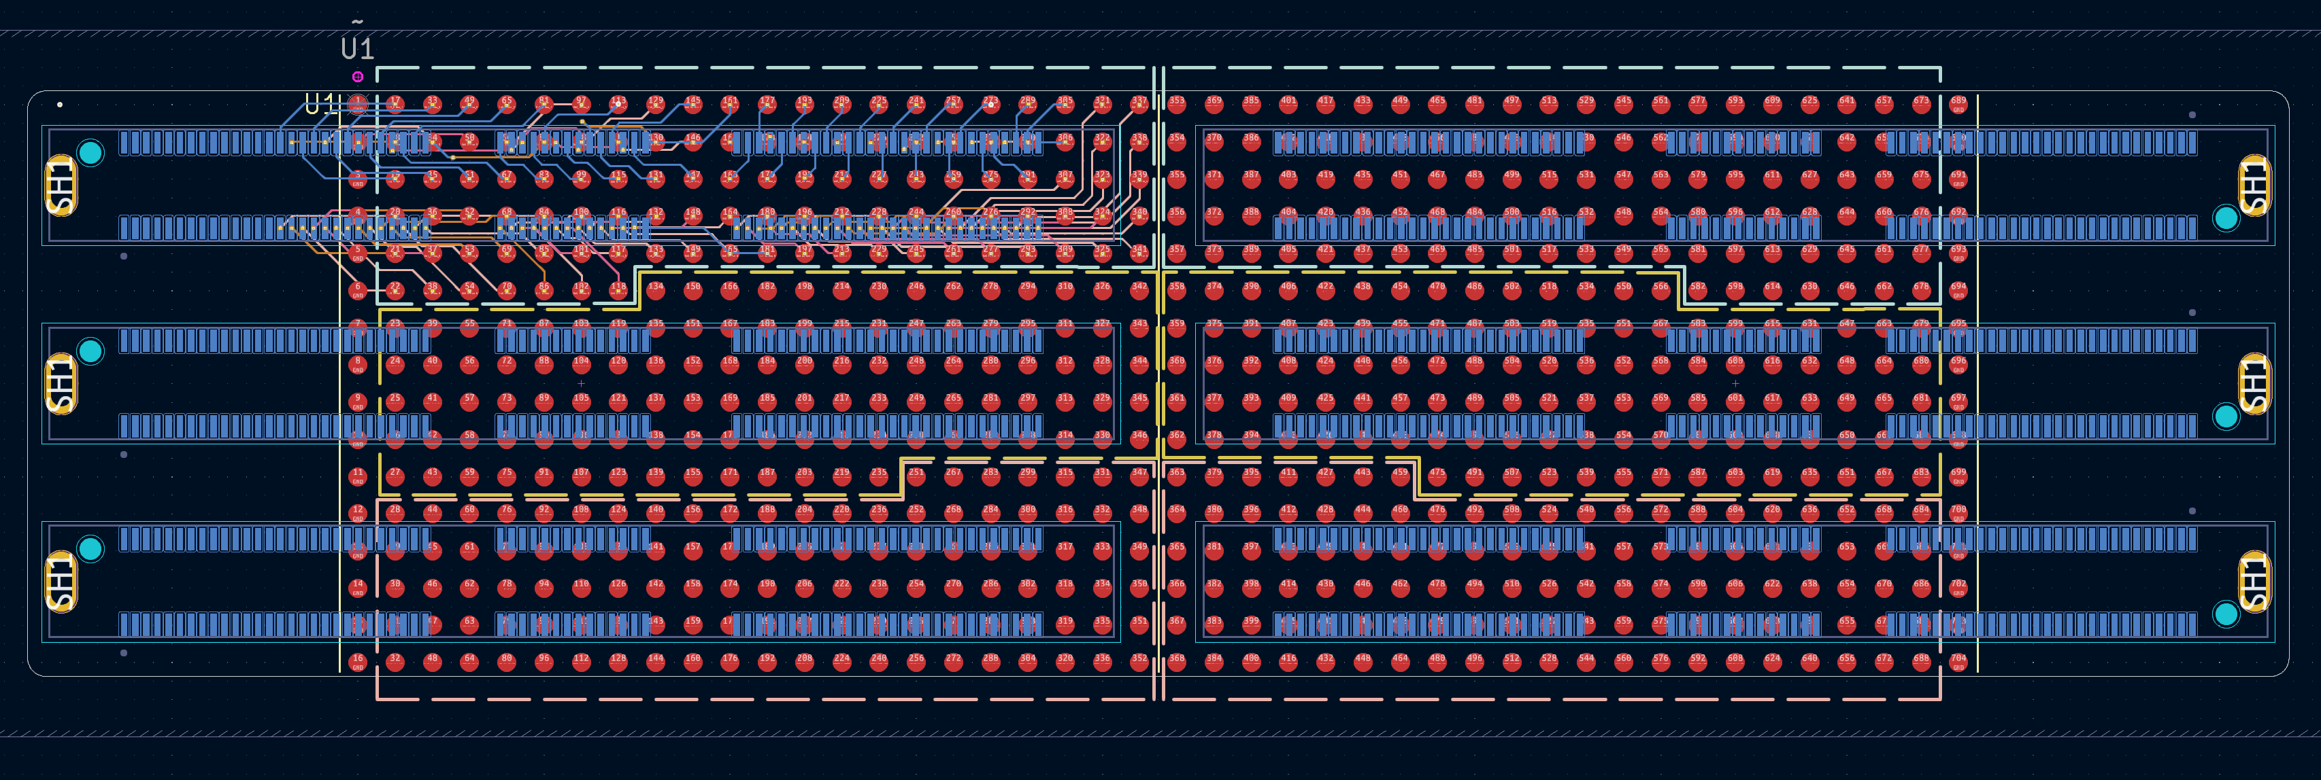
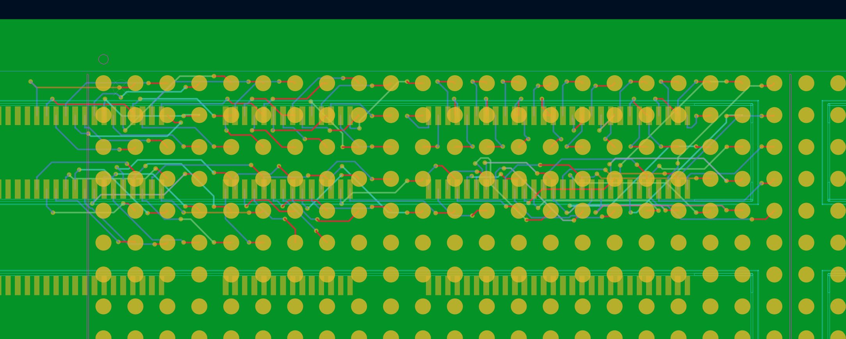
AI Routing
New PCB design to reduce cross talking
- 10 layers stack up (Sig/GND/Sig/GND….GND/Sig) resulting in average capacitance of 96 fF/mm
- Two consecutive Sig layers have perpendicular traces (Maxwell)
- each Sig VIA has a GND one nearby
- 3H rule (distance between two traces is 3 times more than dielectric thikness)
- AI path routing

Slide 5
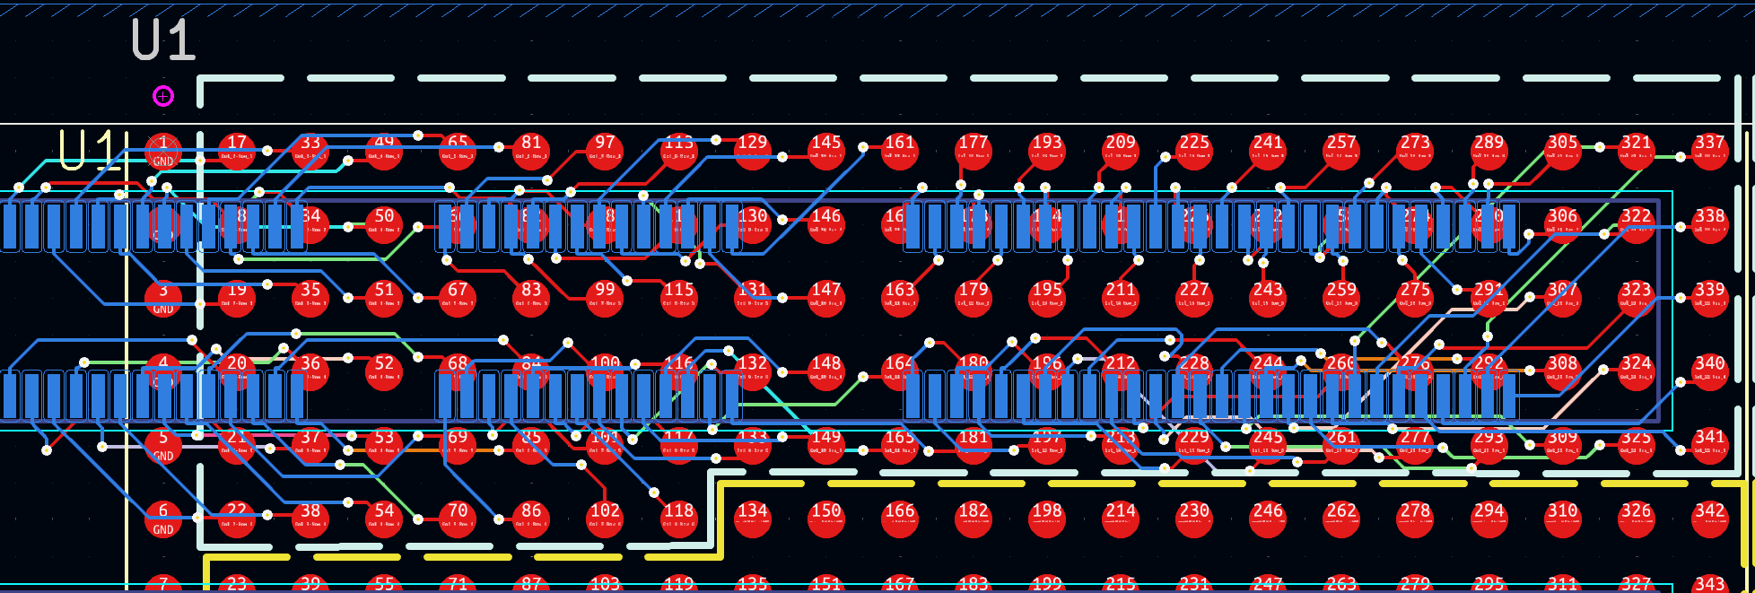
ROI Routed by AI

Slide 6
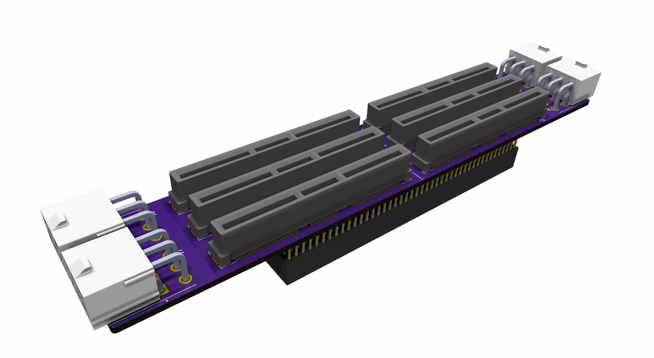
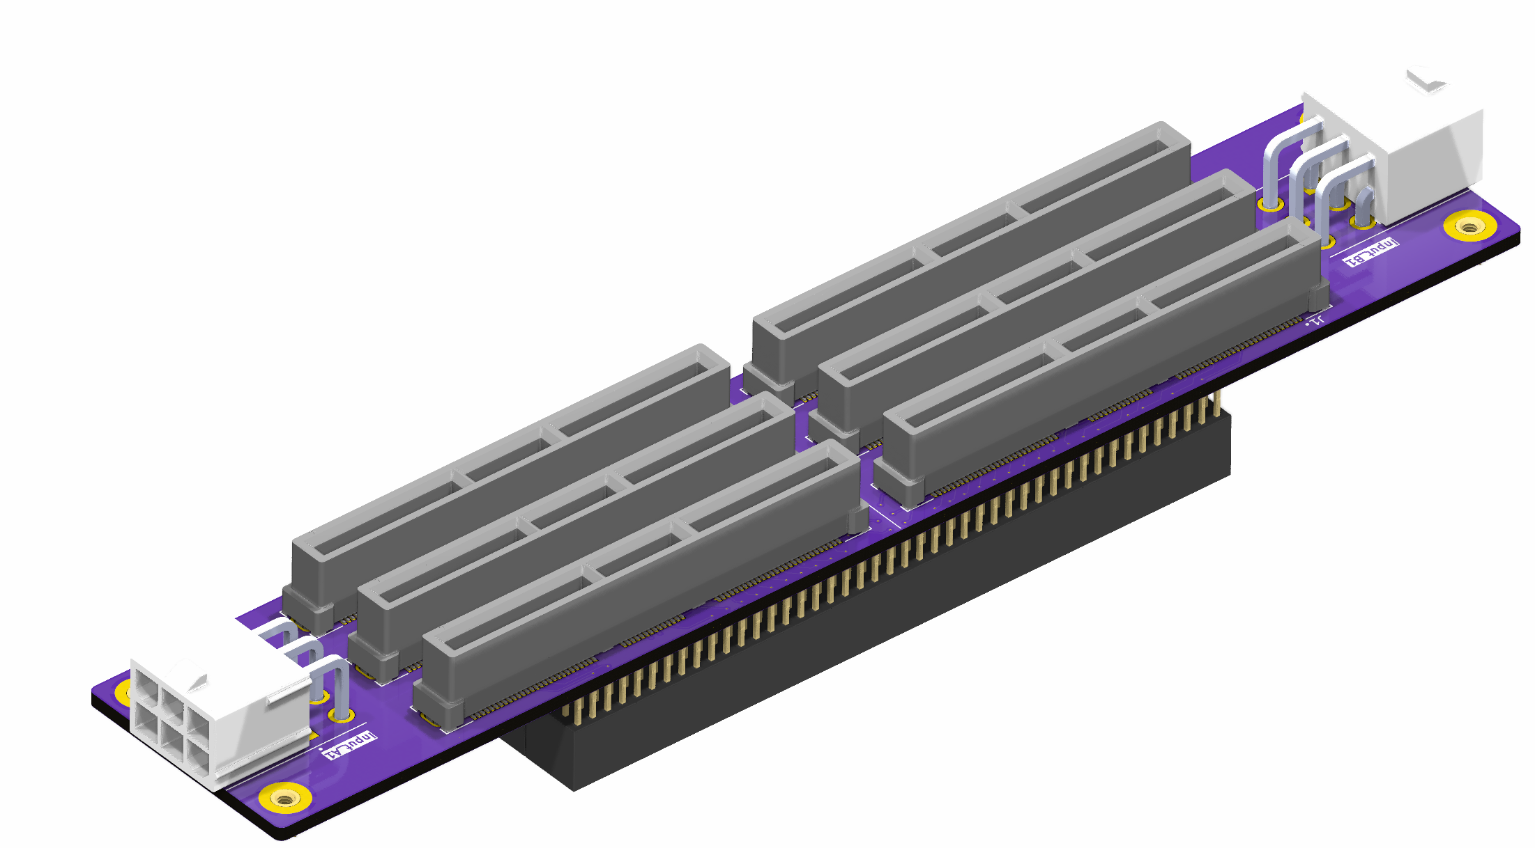
Latest revision
The initial plan…
Power input parameters per VMM3 module:
P1 3.3V/0.2A -> 0.66W
P2 1.8V/1.7A -> 3.06W
TOTAL: 3.72W
Total power input parameters (48 VMM3 modules):
P1 3.3V/9.6A -> 31.68W
P2 1.8V/81.6A -> 146.88W
TOTAL: 178.56W
PCI-E Connector, 1xPin P1, 2xPin P2, 3xPin GND
M2 threaded brass nut for the TPC GND

Slide 7
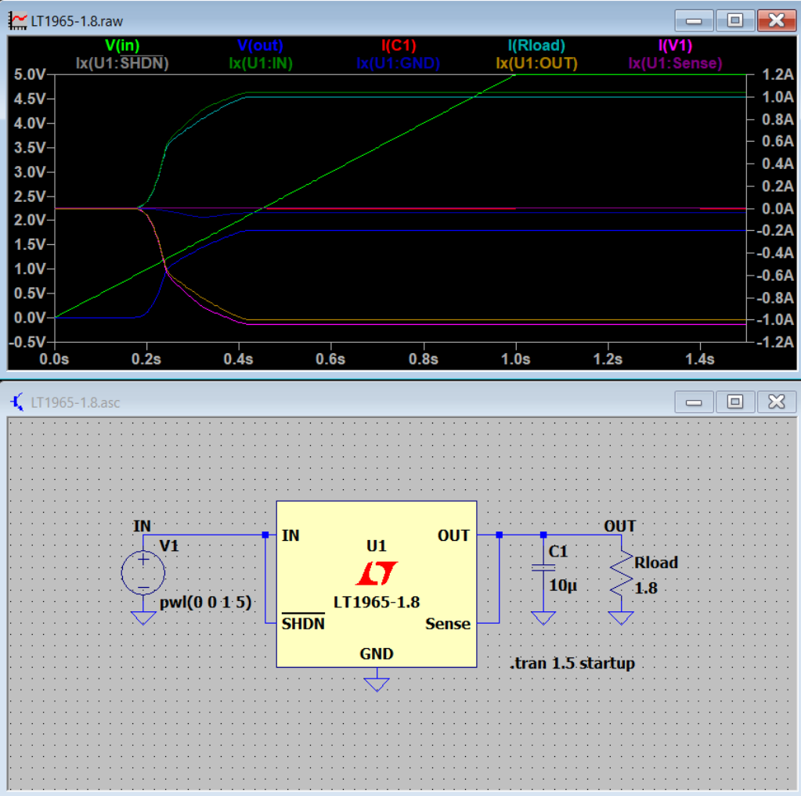
Simulation of the driving circuit of one LT1965-1.8 voltage regulator 1.8V/1.1A
Voltage regulators for P1&P2 phases of 3.3V/0.2A and 1.8V/1.7A

Slide 8
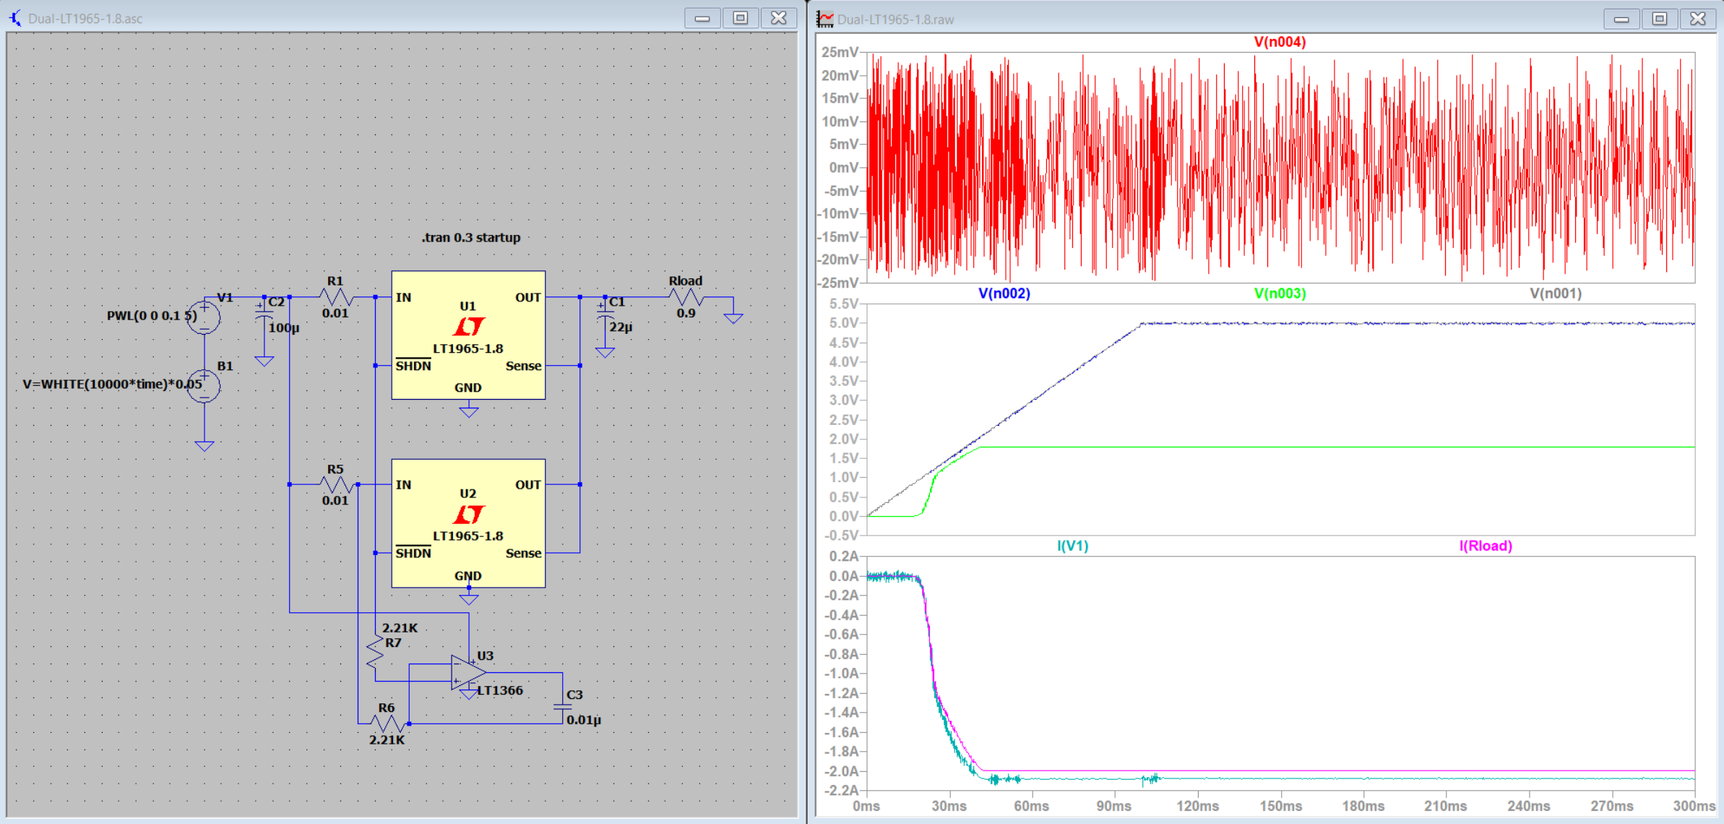
Simulation of the driving circuit of two LT1965-1.8 voltage regulators 1.8V/2.2A in noise conditions
V(n002)
V(n002)
V(n004)
I(V1)
I(Rload)

